Slide 1
Defining What a Project Is and Is-Not

Slide 2
Defining What a Project Is and Is Not

Slide 3
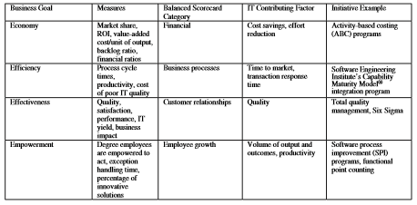
Defining What a Project Is and Is Not
Project vs Operations
Progressive Elaboration
Consider the following points shared by projects and operations:
Both involve employees
Both typically have limited resources: people, money, or both
Both are hopefully designed, executed, and managed by someone in charge
Examples of projects
Designing a new product or service
Converting from one computer application to another
Building a new warehouse
Moving from one building to another
Organizing a political campaign
Designing and building a new airplane
Is the refinement of project concept to project plan
Through incremental steps, the project plan is developed and unique project deliverables are created

